Slide 1
Aspects of Distributed Learning
Presenter:
Enmao Diao (Ph.D. student)
Committee:
Dr. Vahid Tarokh (Advisor)
Dr. David Carlson
Dr. Yiran Chen (MAR)
Dr. Jeffrey Krolik
Dr. Maria Gorlatova
Duke University
Durham, NC
04/09/2021

Slide 2
Outline
Motivation
Objective
Background
Our works
Heterogeneous Federated Learning (HeteroFL) (Published in ICLR 2021) [1]
Gradient Assisted Learning (GAL) (Under review ICML 2021)
Proposed work
Gradient Decentralized Neural Networks (GDNN)
Conclusions
Notes:
First I will talk our motivation and objectives
Then I will introduce some background of distributed learning
Next I will demonstrate our previous works HeteroFL and GAL
Then I will propose a future work named GDNN
Finally I will draw my conclusions

Slide 3
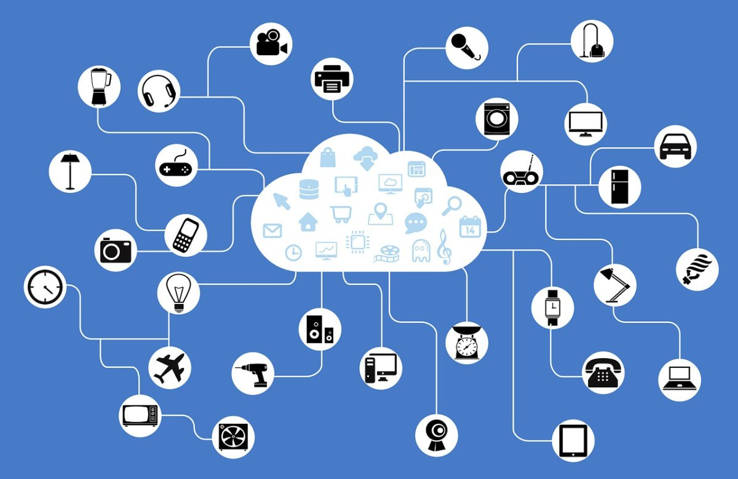
Motivation
Mobile devices and the Internet of Things (IoT) devices are becoming the primary computing resource for billions of users worldwide
Figure 1. The booming era of Internet of Things (IoT) and Edge Computing.
Notes:
In the booming era of ….

Slide 4
Motivation
Mobile devices and the Internet of Things (IoT) devices are becoming the primary computing resource for billions of users worldwide
Generate a significant amount of data across heterogeneous devices
Improve the performance of applications by storing and processing data locally
We are interested in
A large-scale autonomous distributed learning framework
A practical and complete solution to the limitations of current practices
Notes:
In fact, there are two major underlying characteristics of this new technology development
Closer to the user
To propose a

Slide 5
Objective
Our objective is to develop a distributed learning system that addresses following aspects
The system can learn and predict with deep learning models in a distributed setting
The system allows heterogeneous data distribution
The system avoids communication of raw data to preserve data privacy
The system assures model autonomy of local computing agents
The system is computation and communication efficient
Notes:
Most of the current works only touch on these two cases separately.
I talk about the taxonym of data heterogeneity later
Local agents have more choices on choosing their training model architecture and possibly use them for business purposes
Finally, compared to existing distributed learning frameworks

Slide 6
Background
Distributed Learning and Prediction
Distributed Stochastic Gradient Descent (D-SGD) [2]
Learning ✓, Prediction ✗
Synchronized communications of frequent gradient updates
Distributed Deep Neural Networks (DDNN) [3]
Learning ✗, Prediction ✓
Distribute subnetworks hierarchically from cloud to end devices
Federated Learning (FL) [4]
Learning ✓, Prediction ✗
Reduces communication cost by allowing clients to train multiple iterations locally
Notes:
Here I will introduce some background of the five aspects I just mentioned.
The computation of learning and prediction can occur in distributed entities instead of a centralized server
Some pioneer works like D-SGD and DDNN address distributed learning and prediction separately but not simultaneously
D-SGD ..
DDNN …
Recently, a new topic named FL
We aim to develop a framework that can simultaneously learn and predict in a distributed fashion and communicate less often

Slide 7
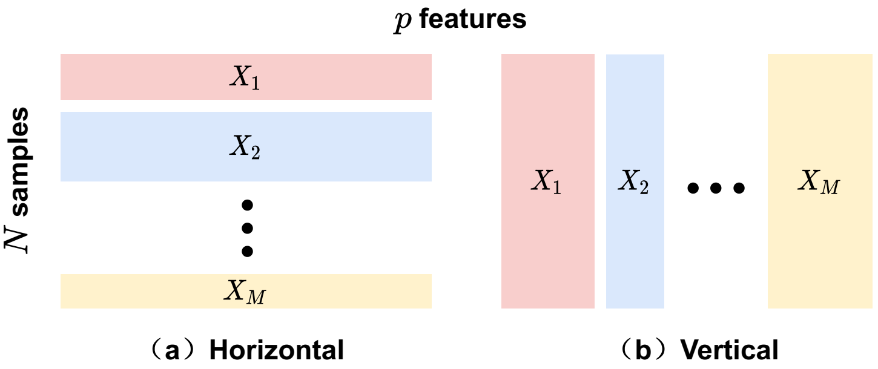
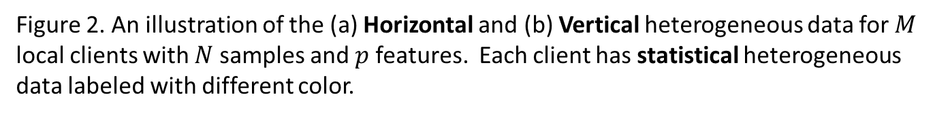
Background
Data Heterogeneity [5, 6]
Horizontal heterogeneous data share the same feature space but different in samples
Vertical heterogeneous data share the data samples but different in feature spaces
Statistical heterogeneous data labeled and distributed in a Non-IID fashion
Figure 2. An illustration of the (a) Horizontal and (b) Vertical heterogeneous data for $M$ local clients with $N$ samples and $p$ features. Each client has statistical heterogeneous data labeled with different color.
Notes:
Now I will introduce the categorization of data heterogeneity in distributed learning
H
V
S
For exam
For example, in MNIST …
Here we show an illustration of these three data heterogeneity.
I should emphasize that these three scenarios could happen at the same time but most of the works address at most two of such cases.
We aim to provide a complete solution for these three data heterogeneity at the same time.

Slide 8
Background
Data Privacy
Differential Privacy [7]
Injecting some amount of noise to transmitted raw data
A trade-off between privacy and performance
Interval Privacy [8]
Randomly quantizing transmitted raw data
A trade-off between privacy and performance
Federated Learning (FL) [9, 10]
Frequent gradient updates can leak raw data information
[Global privacy] Model updates private to all participants other than the central server
[Local privacy] Model updates are also private to the server
Notes:
Another key issue in distributed learning is data privacy
I should say that
Privacy in distributed learning is still an on-going research
Although, there are some pioneer theoretical works like DP and Interval Privacy.
In DP, ….
In Interval privacy
In the case FL, the learning framework provide a heuristic guarantee of data privacy through communications of trained model parameters.
However, some recent works show that …
There are also some works try to avoid the server knowing the model updates by adopting DP
Based on my experience, I heuristically summarize in order to maintain data privacy as much as possible
Avoid transmit raw data
Avoid frequently transmit model updates
Avoid frequently transmit intermediate features in the deep learning models

Slide 9
Background
Model Autonomy
local clients have the flexibility to choose their learning model architecture considering issues like
Local computation and communication capabilities
Local learning framework availability
Federated Distillation (FD) [11, 12]
Distill with auxiliary dataset or summarized predictions
Compromise data privacy and degrade the performance
Our works
HeteroFL shows that local model architectures can be smaller than global model architecture
GAL allows various entities to assist each other without sharing data and models
Notes:
Model autonomy is one of our main interests, because if the local clients ..
Then, these models can be choosed based on …
A interesting digression of FL is FD in which they auxiliary dataset to summarize the prediction for knowledge distillation. However, this method typically compromises data….
Our previous works contributes on this direction. For example, …
We will talk about these work in details later

Slide 10
Background
Efficiency
Computation
Model Compression
Communication
Data Compression
Fast convergence
Our works
Restricted Recurrent Neural Networks (RRNN) [13]
Deep Clustering of Compressed Variational Embeddings [14]
Distributed Recurrent Autoencoder for Scalable Image Compression (DRASIC) [15]
Dimension Reduced Turbulent Flow Data From Deep Vector Quantizers [16]
HeteroFL [1] and GAL
Notes:
Finally, one the key motivation of this new distributed learning system is that compared to existing works, it has computation and communication advantage
To save the computation cost of learning and prediction with deep learning models, we can use model compression
Through quantization and low-rank approximation
To save the communication cost, we can develop a more efficient learning framework which requires less communication but more local training.
We can also compress the transmission with data compression techniques.
Some of our previous works shown here have studied this topic.
For example,
In RRNN we provide a model that use less model parameters compared to classical RNN and achieve the similar results
In DRASIC, we develop a distributed compression framework for IID and Non-IID distributed data

Slide 11
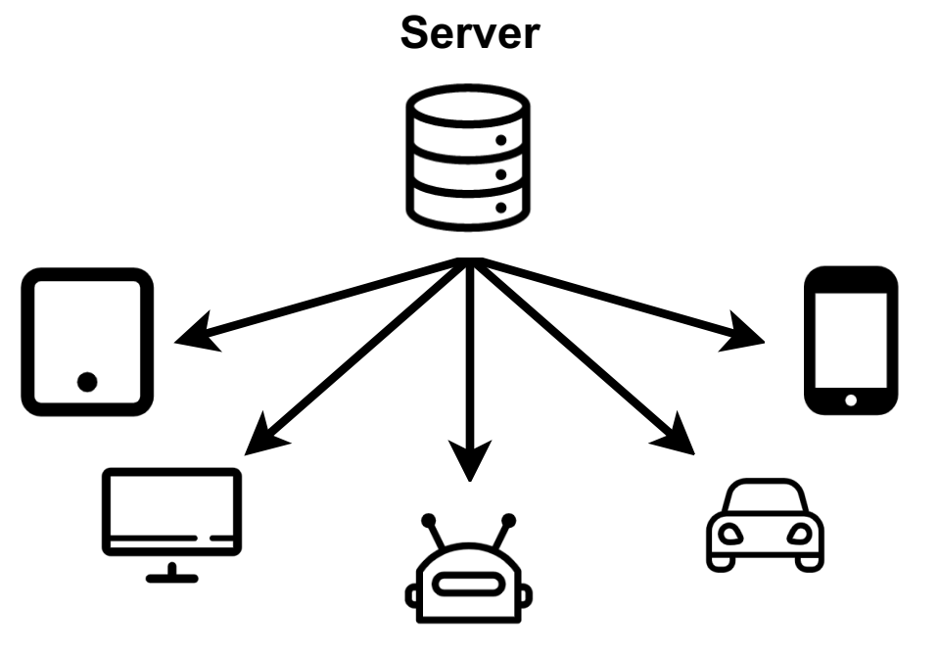
Heterogeneous Federated Learning
Motivation
Emerging: a large set of heterogeneous IoT devices
Federated Learning: one global model architecture for all client devices
Figure 3. The computation and communication capabilities of each local client may vary significantly and even dynamically.
Notes:
Now, I will talk about our published work, Heterogenous Federated Learning
As mentioned before, there exists
Existing FL methods assume that we should train a global model architecture that is shared for all local clients
However, as shown in the figure the computation …

Slide 12
Heterogeneous Federated Learning
Local models must share the same architecture as the global model in federated learning?
Figure 3. The computation and communication capabilities of each local client may vary significantly and even dynamically.
Notes:
Therefore, We challenge the notion that
This idea is in fact accepted by not only FL but also classical distributed optimization community

Slide 13
Heterogeneous Federated Learning
HeteroFL: to enable the training of heterogeneous local models with dynamically-varying computation complexities, while still producing a single global inference model!
Figure 3. The computation and communication capabilities of each local client may vary significantly and even dynamically.
Notes:
We propose HeteroFL…

Slide 14
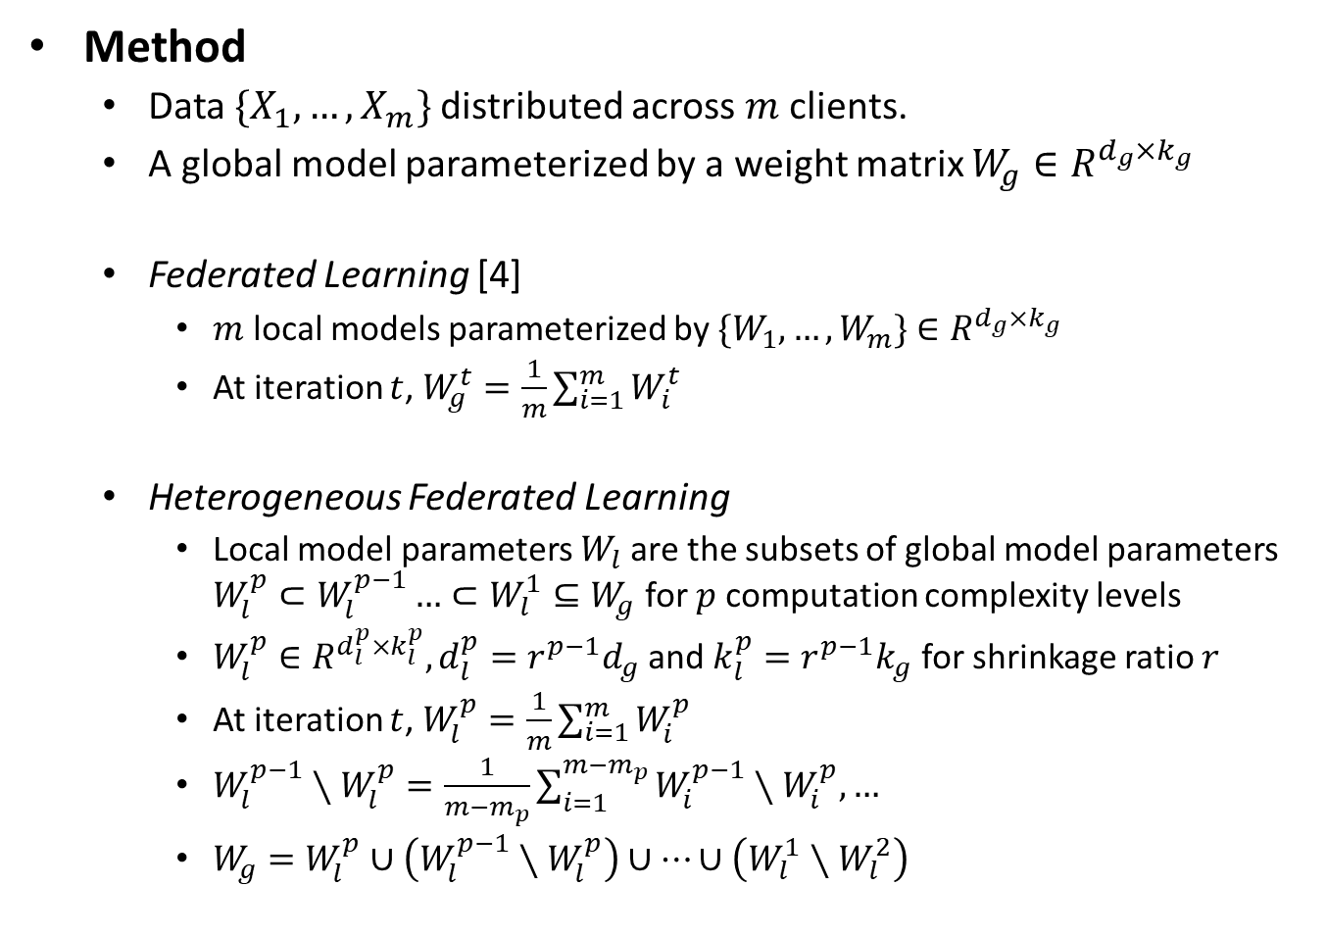
Heterogeneous Federated Learning
Method
Data $\{X_{1},…,X_{m}\}$distributed across $m$ clients.
A global model parameterized by a weight matrix $W_{g}∈R^{d_{g}×k_{g}}$
Federated Learning [4]
$m$ local models parameterized by $\{W_{1}, …,W_{m}\}$ $∈R^{d_{g}×k_{g}}$
At iteration $t$, $W_{g}^{t}=\frac{1}{m}\sum_{i=1}^{m}{W_{i}^{t}}$
Heterogeneous Federated Learning
Local model parameters $W_{l}$are the subsets of global model parameters $W_{l}^{p}⊂W_{l}^{p−1}…⊂W_{l}^{1}⊆W_{g}$ for $p$computation complexity levels
$W_{l}^{p}∈R^{d_{l}^{p}×k_{l}^{p}}, d_{l}^{p}=r^{p−1}d_{g}$and $k_{l}^{p}=r^{p−1}k_{g}$ for shrinkage ratio $r$
At iteration $t$, $W_{l}^{p}=\frac{1}{m}\sum_{i=1}^{m}{W_{i}^{p}}$
$W_{l}^{p−1}∖W_{l}^{p}=\frac{1}{m−m_{p}}\sum_{i=1}^{m−m_{p}}{W_{i}^{p−1}}∖W_{i}^{p},…$
$W_{g}=W_{l}^{p}∪\left(W_{l}^{p−1}∖W_{l}^{p}\right)∪…∪\left(W_{l}^{1}∖W_{l}^{2}\right)$
Notes:
Here we will demonstrate our method in details.
The global model parameters will be averaged from local model paremeters
For example , the most capable device
At iteration t

Slide 15
Heterogeneous Federated Learning
Miscellaneous Techniques
Static Batch Normalization (sBN) does not track running estimates and cumulatively update global BN statistics after training is finished
Scaler scales representations during the training phase and the global model can be directly used for inference without scaling
Masked Cross-Entropy Loss replaces the last layer outputs that are not associated with local labels as zero
Notes:
In this work, we also propose other techniques that stabilize the training of the heterogenous models.
sBN
We introduce scaler module to because each local model has different size of parameter matrix and thus the scale of the representations are different This idea originates from dropout. By using this scaler
We also introduce masked-ce for Non-IID data partition. We replaces … This approach significantly improves local performance

Slide 16
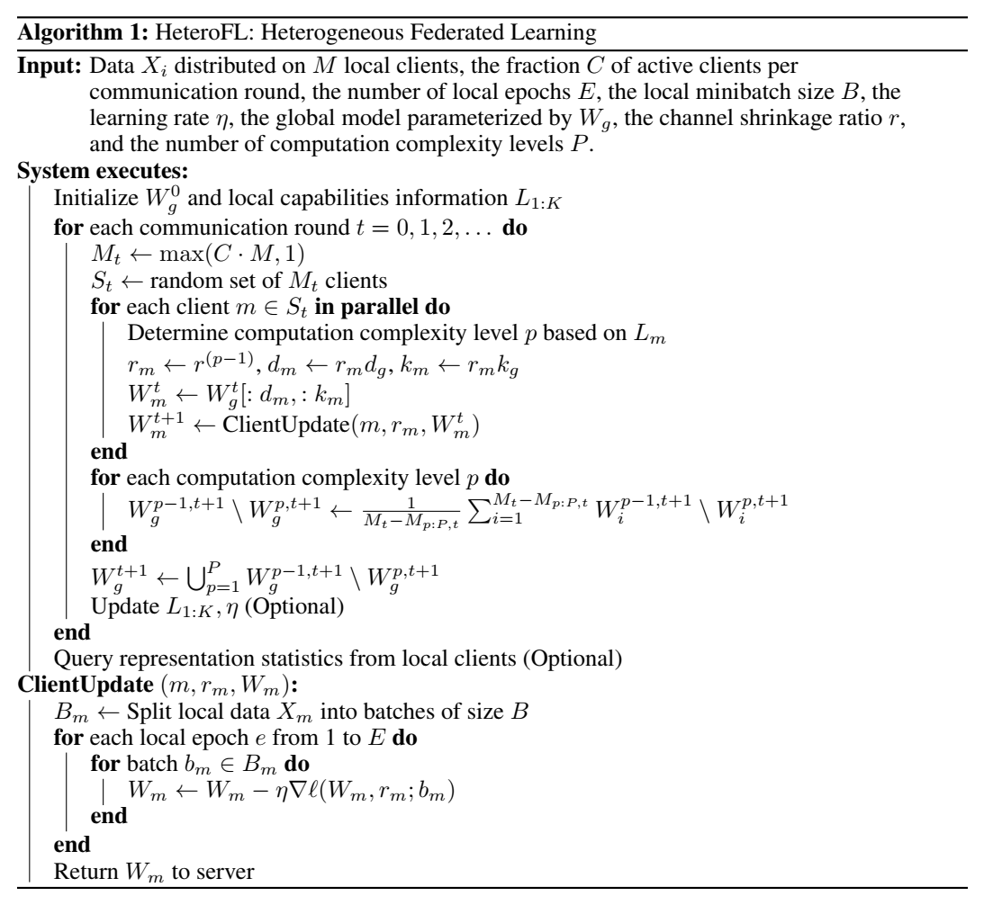
Heterogeneous Federated Learning
Algorithm
Notes:
With all the practical methods mentioned above, we propose the complete pseudo-code for our HeteroFL framework.
The local capabilities information Lm is an abstraction of the computation and communication ability Once this information is communicated to the server, the server can know the model complexity level that should be allocated to the client. We can also optionally update learning rates to facilitate optimization and local capabilities information if changing dynamically.

Slide 17
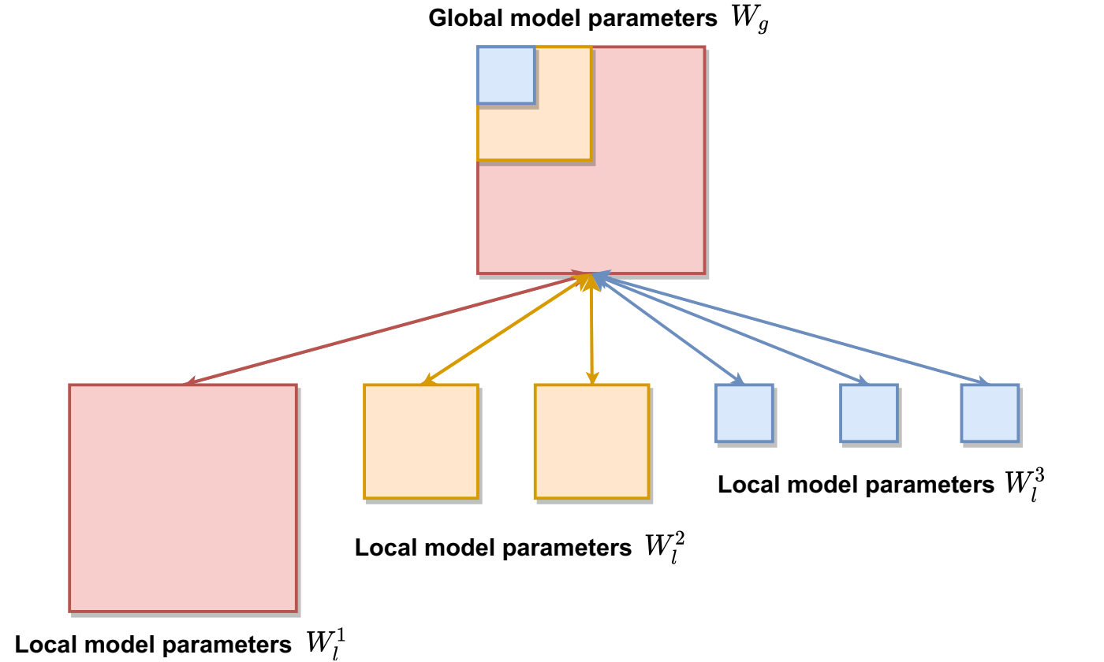
Heterogeneous Federated Learning
Small local models can benefit from FL by performing global aggregation on a part of larger local model parameters
Figure 4. Global model parameters are distributed to $6$ local clients with $3$ computation complexity levels.
Notes:
Here we illustrate an example of our proposed method
We show global model parameters….
We demonstrate that
In fact We also try Uniformly sample subnetworks

Slide 18
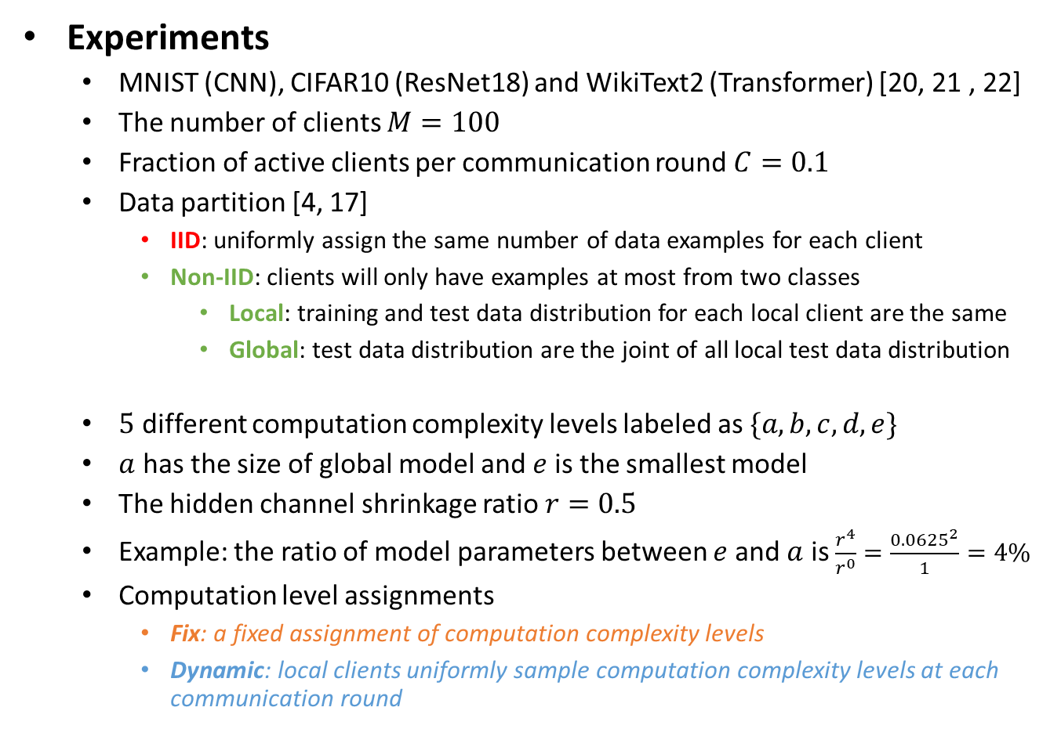
Heterogeneous Federated Learning
Experiments
MNIST (CNN), CIFAR10 (ResNet18) and WikiText2 (Transformer) [20, 21 , 22]
The number of clients $M=100$
Fraction of active clients per communication round $C=0.1$
Data partition [4, 17]
IID: uniformly assign the same number of data examples for each client
Non-IID: clients will only have examples at most from two classes
Local: training and test data distribution for each local client are the same
Global: test data distribution are the joint of all local test data distribution
$5$ different computation complexity levels labeled as $\{a,b,c,d,e\}$
$a$ has the size of global model and $e$ is the smallest model
The hidden channel shrinkage ratio $r=0.5$
Example: the ratio of model parameters between $e$ and $a$ is $\frac{r^{4}}{r^{0}}=\frac{{0.0625}^{2}}{1}=4\%$
Computation level assignments
Fix: a fixed assignment of computation complexity levels
Dynamic: local clients uniformly sample computation complexity levels at each communication round
Notes:
Now we talk about our experimental setup

Slide 19
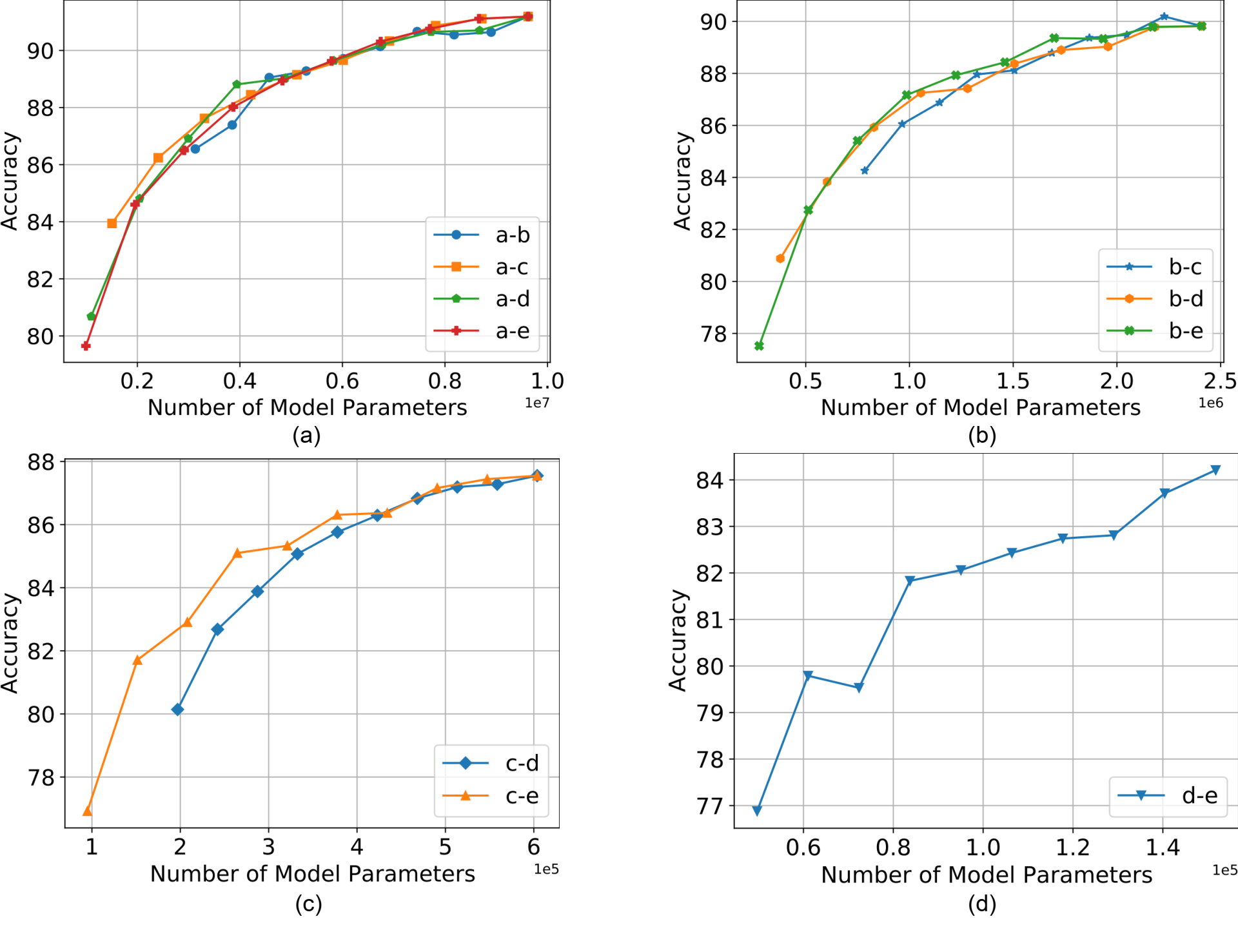
Heterogeneous Federated Learning
Results
Figure 5. Interpolation experimental results for CIFAR10 (IID, Fix) dataset between global model complexity and various smaller model complexities (denoted by a, b, c, d).
Notes:
If some of clients are very strong, they can help other smaller models to achieve similar results as if all clients are strong

Slide 20
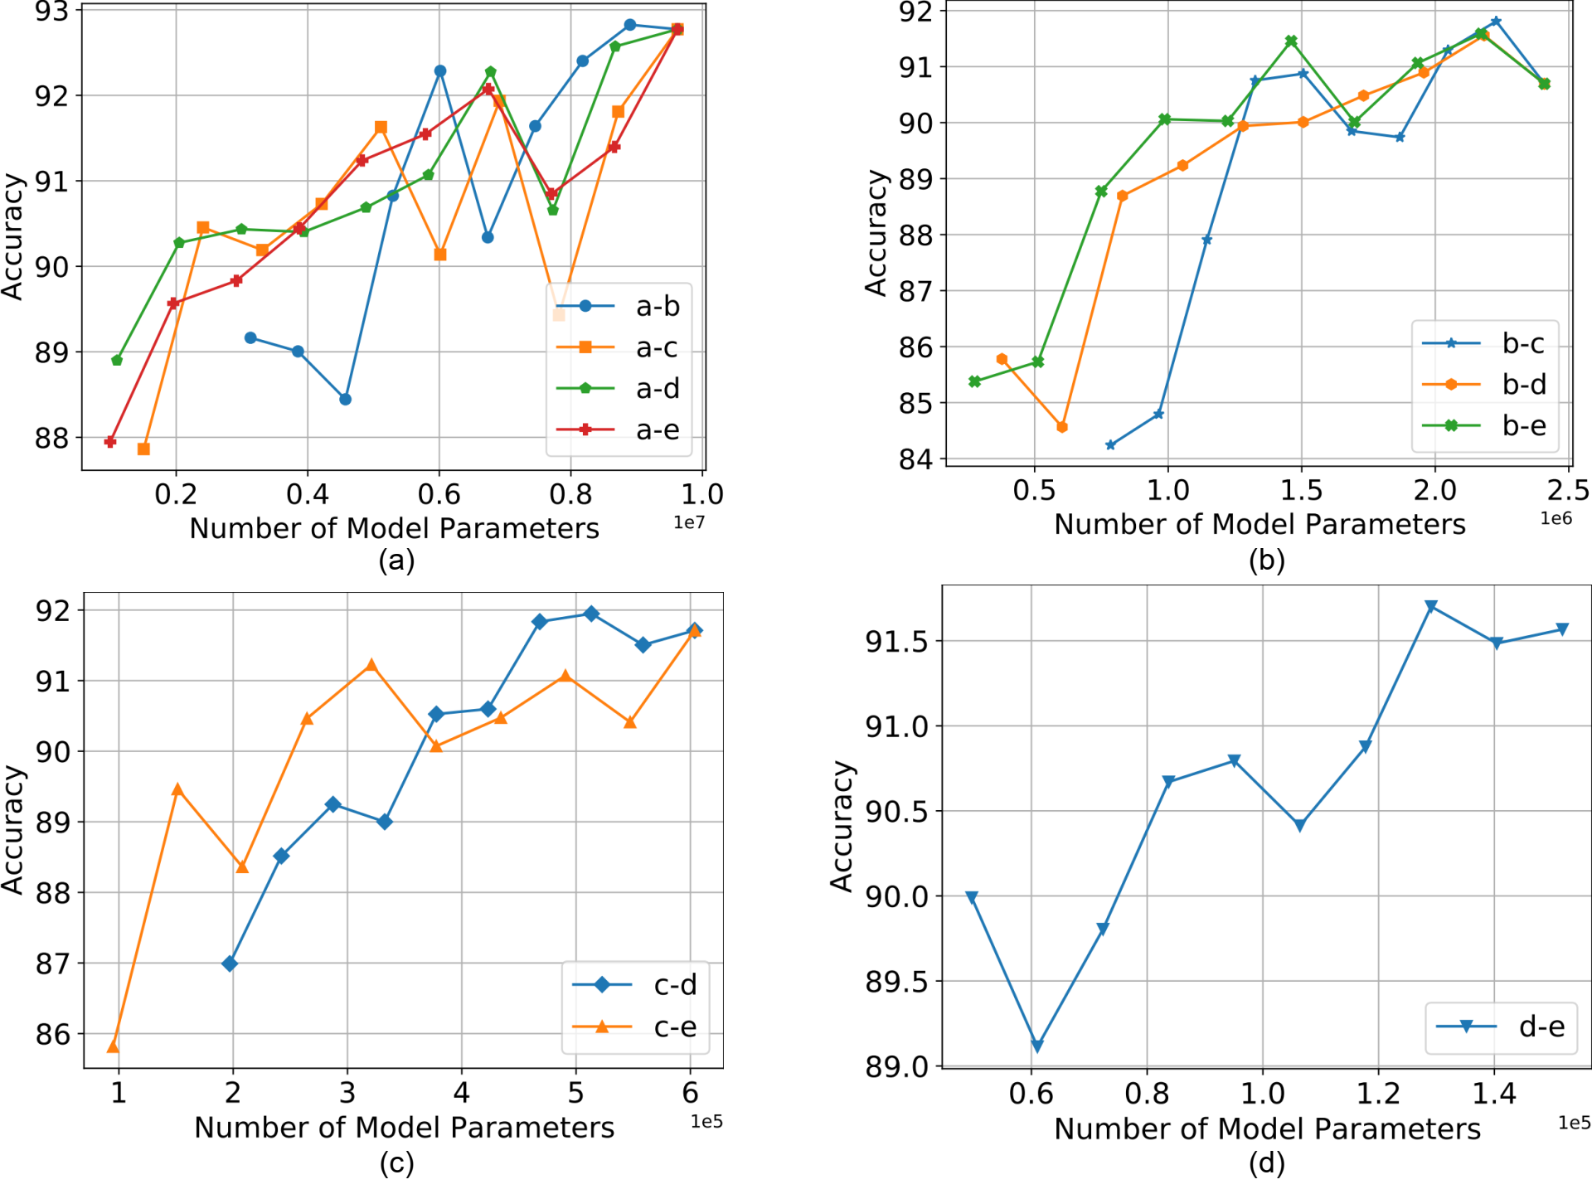
Heterogeneous Federated Learning
Results
Figure 6. Interpolation experimental results for CIFAR10 (Non-IID, Local, Fix) dataset between global model complexity and various smaller model complexities (denoted by a, b, c, d).

Slide 21
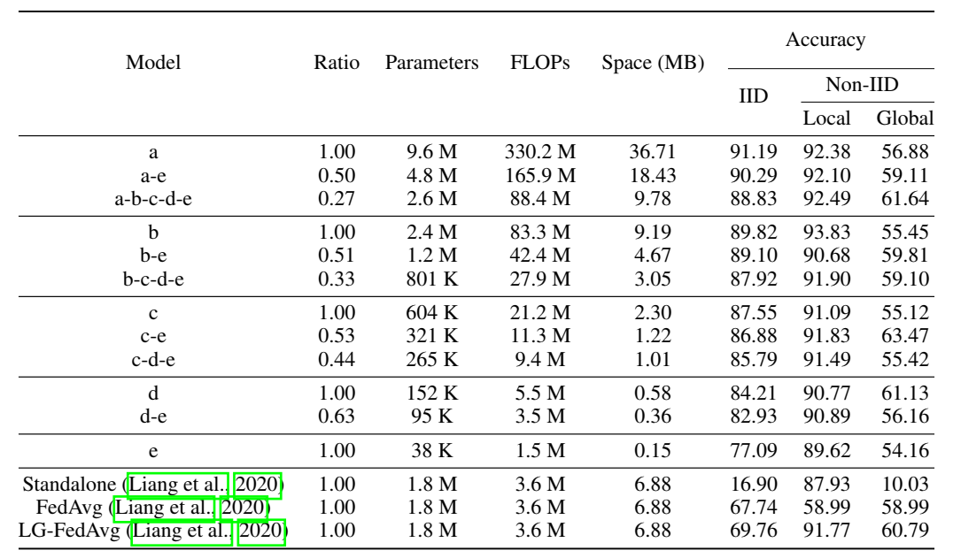
Heterogeneous Federated Learning
Results
Table 1. Results of combination of various computation complexity levels for CIFAR10 dataset (Dynamic).
Notes:
Our proposed method significantly outweighs baseline methods in terms of computation ,communication cost and model performance

Slide 22
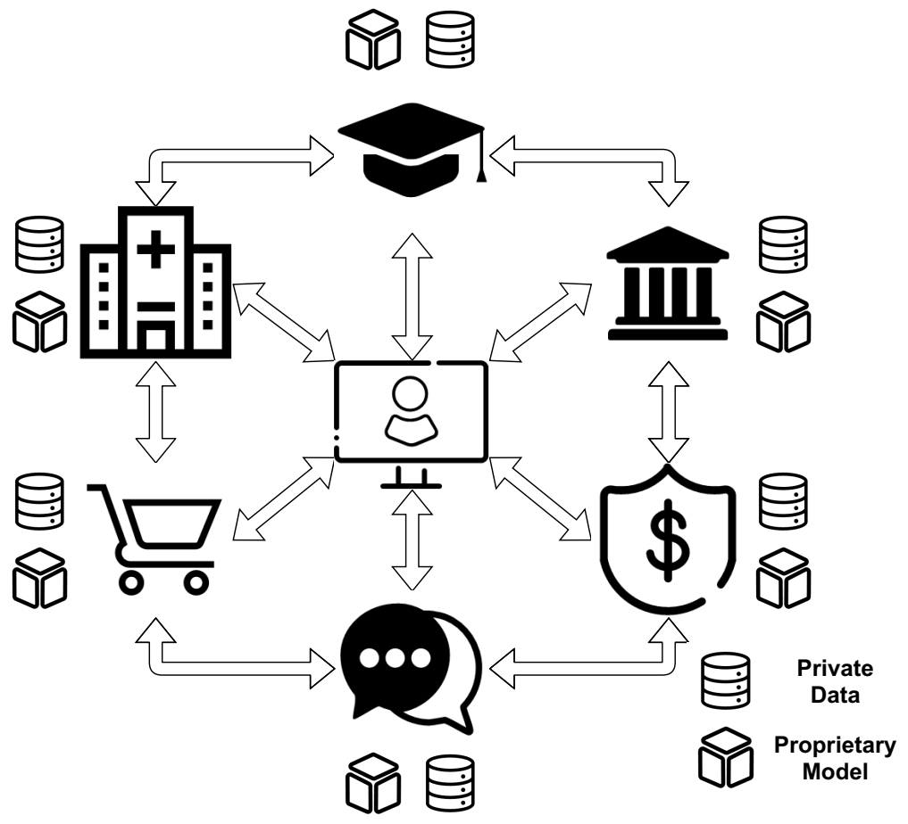
Gradient Assisted Learning
Motivation
Collaborative learning may have various scientific and business applications, but decentralized organizations do not want to share private data and proprietary model
Figure 7. Decentralized organizations form a community of shared interest to provide better Machine-Learning-as-a-Service (MLaaS).
Notes:
a medical institute may be helped by multiple clinical laboratories and pharmaceutical entities to improve clinical treatment and facilitate scientific research (Farrar et al., 2014; Lo, 2015). Financial organizations may collaborate with universities and insurance companies to predict loan default rates (Zhu et al., 2019). As the above organizations hold heterogeneous features from a potentially similar group of people We aim to develop a learning framework such that ….
Emphasize that this topic focuses on vertical heterogenous data

Slide 23
Gradient Assisted Learning
Related Works
Ensemble methods
Data Fusion requires every learner to have the training labels
Gradient Boosting [18] does not support vertical heterogeneous data
Vertical Federated Learning
SplitNN [19] and VAFL [20] require synchronization and much more communication rounds
Assisted Learning (AL) [21]
Generalize from squared loss for regression to any differentiable loss
Generalize from sequential protocol to parallel aggregation for multiple entities
Notes:
There exists some related works like
Our work is based on

Slide 24
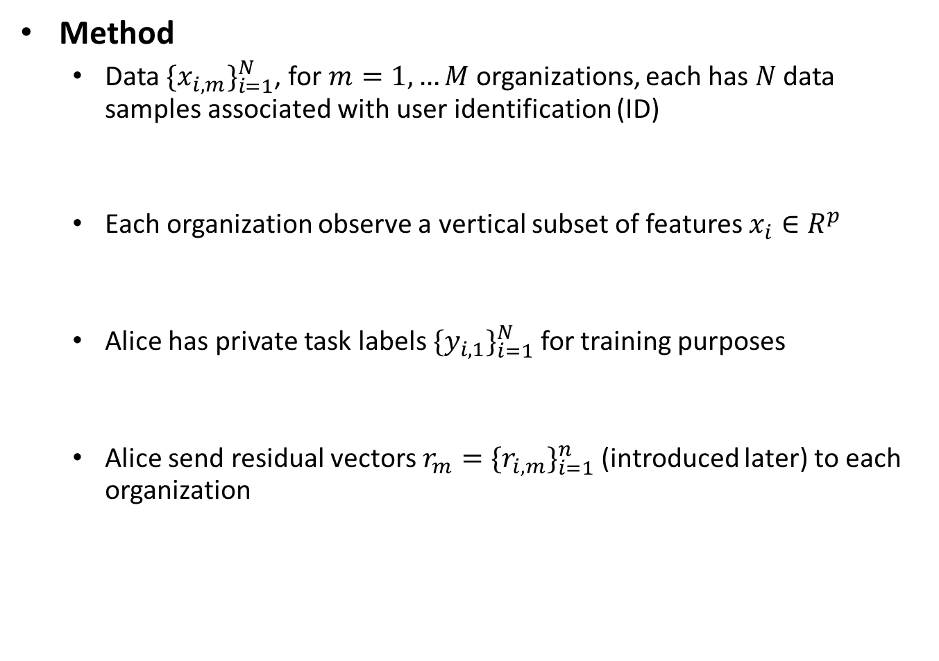
Gradient Assisted Learning
Method
Data $\{x_{i,m}\}_{i=1}^{N}$, for $m=1,…M$ organizations, each has $N$ data samples associated with user identification (ID)
Each organization observe a vertical subset of features $x_{i}∈R^{p}$
Alice has private task labels $\{y_{i,1}\}_{i=1}^{N}$ for training purposes
Alice send residual vectors $r_{m}=\{r_{i,m}\}_{i=1}^{n}$ (introduced later) to each organization
Notes:
We demonstrate our gradient assisted learning method
under standard regularization condition

Slide 25
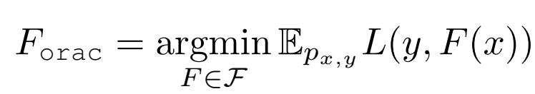
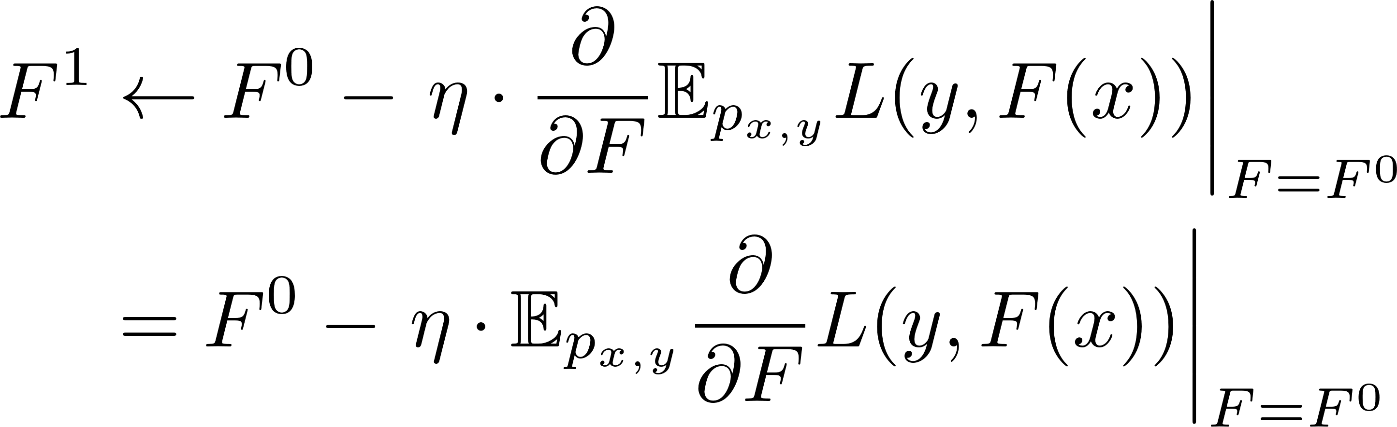

Gradient Assisted Learning
Method
Let $ℱ$denote the set of all available models $F∈ℱ$
In oracle case where all data are centralized, we have
A standard gradient descent step
where $η$is the gradient assisted learning rate
Notes:
under standard regularization condition

Slide 26
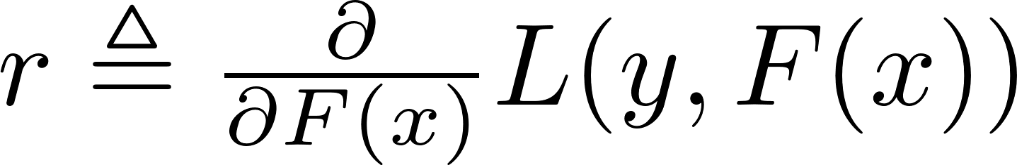
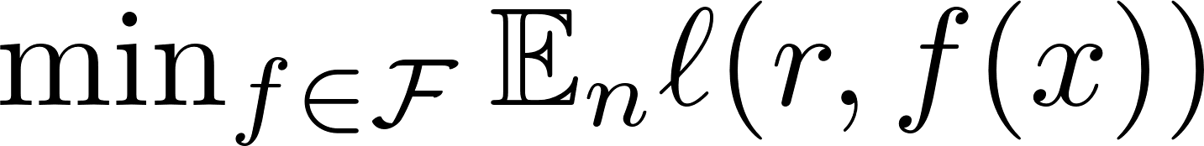
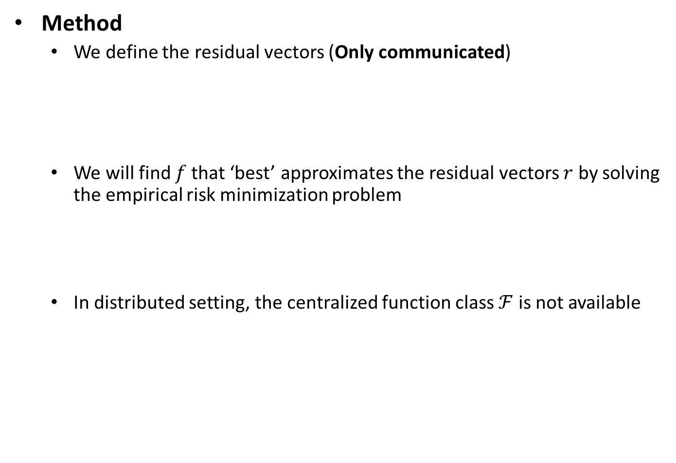
Gradient Assisted Learning
Method
We define the residual vectors (Only communicated)
We will find $f$that ‘best’ approximates the residual vectors $r$ by solving the empirical risk minimization problem
In distributed setting, the centralized function class $ℱ$ is not available
Notes:
we approximate the model class with a weighted mixture of local orgnanizations

Slide 27

Gradient Assisted Learning
Method
We approximate $ℱ$ with a weighted mixture
where $w_{m}$gradient assistance weights from a simplex $P_{M}$
Notes:
we approximate the model class with a weighted mixture of local organizations

Slide 28
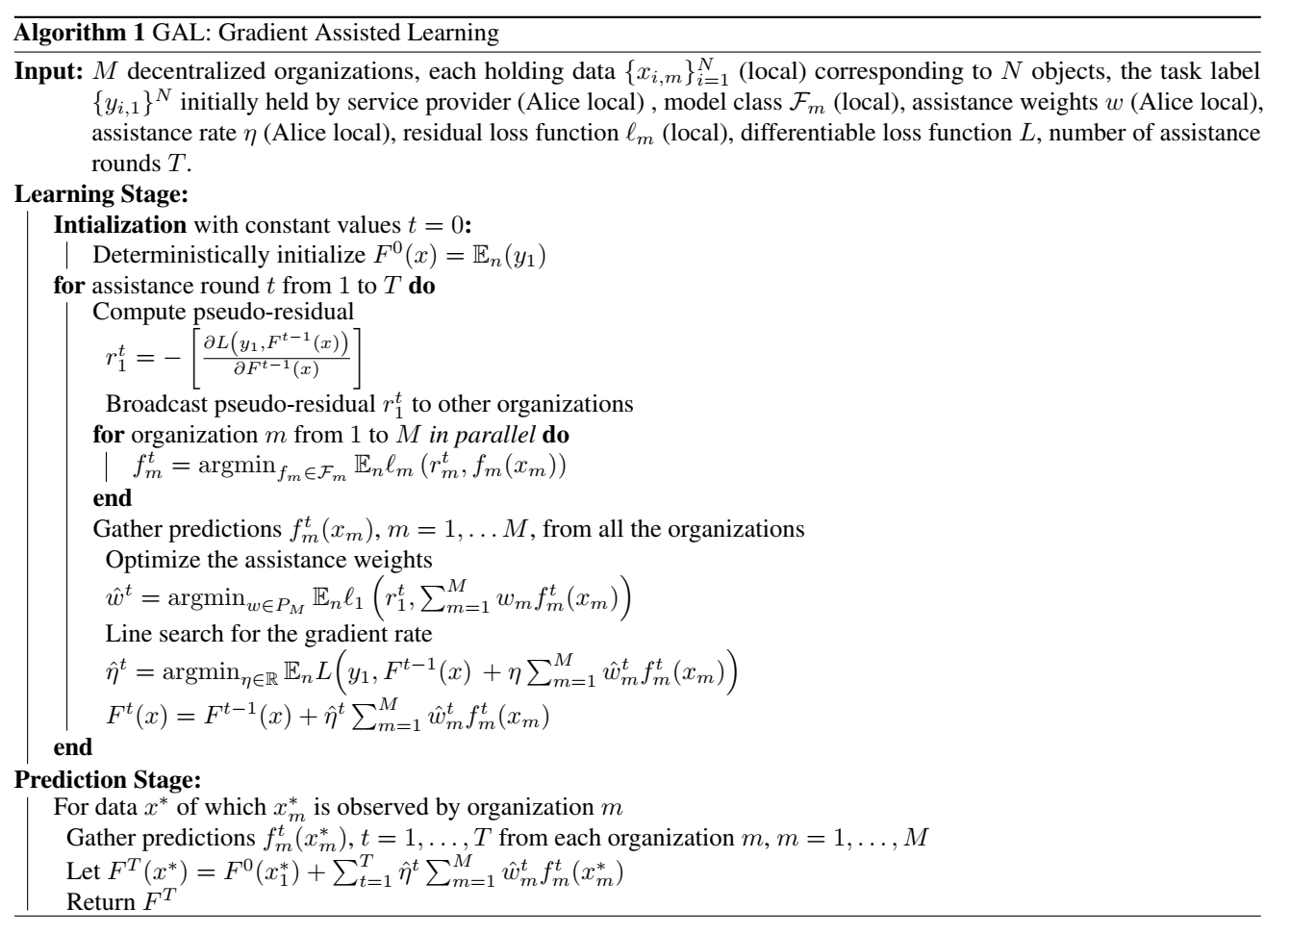
Gradient Assisted Learning
Algorithm
Notes:
This is the pseudo-code of our proposed algorithm
Alice initializes with an initial guess for F0(x) based only on its own data.
Alice broadcasts r1 (named pseudo residuals) to organization m; m = 2; · · · ; M, who will then fit a local model to learn fm.
Each organization will then send the fitted values to Alice, who will train suitable weights wm.
Subsequently, Alice finds the η through line search
The procedure can be iterated for a finite number of rounds until Alice creates a satisfactory approximation of the oracle
Gradient assisted learning rate $η$
Fast convergence with line search
Stop criterion
Gradient assistance weights $w$
Robust against adversarial attack
organization (meta-feature) selection

Slide 29
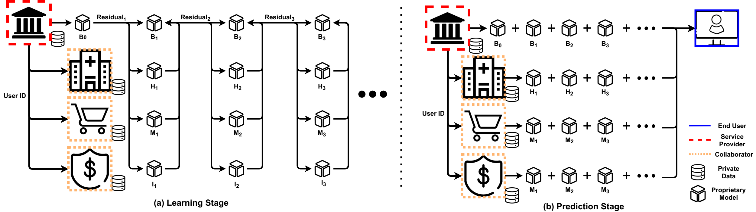
Gradient Assisted Learning
Each organization can operate on its own local data and model
Figure 8. （a) Learning and (b) Prediction Stage for Gradient Assisted Learning.
Notes:
Here we illustrate the learning and prediction stage of GAL
Alice, the bank here squared in red dashed line, is the organization to be assisted.
Before learning, it broadcasts user identification (ID) to locate and align vertical hetergeneous data We follow the standard initialization of Gradient boosting.
We note that organizations have complete autonomy on model fitting. In particular, they have the ability to choose their own learning algorithms and models by considering their resources (e.g., computation power). Next, the bank will aggregate all the predictions from each organization’s local models by optimizing assistance weights and line search for the learning rate.
During the Prediction Stage, organizations will predict with trained models at every assistance round and transmit their predictions to the bank. In contrast to the Learning Stage, the synchronization of each organization is unnecessary. The final prediction is computed by the bank together with trained assistance weights, learning rates, and predictions.

Slide 30
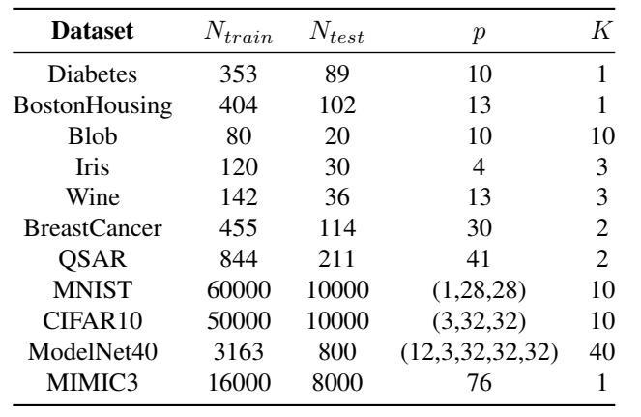
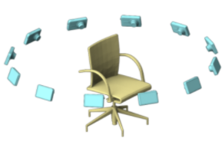
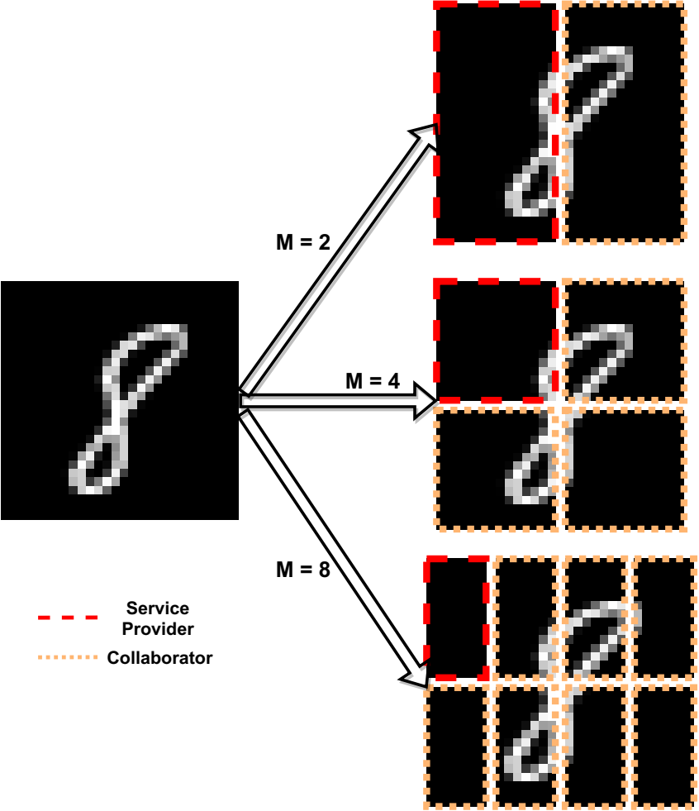

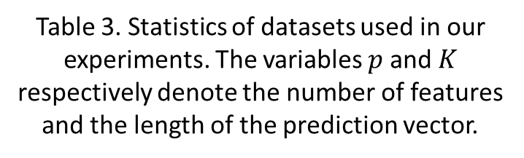
Gradient Assisted Learning
Experiments
UCI datasets (Linear), MNIST (CNN), CIFAR10 (CNN), ModelNet40 (MVCNN), MIMIC3 (LSTM) [22, 23]
The number of organizations $m=\{2, 4, 8\}$, $12$for ModelNet40
Regression (Mean Absolute Difference) and Classification (Cross-Entropy)
Table 3. Statistics of datasets used in our experiments. The variables $p$ and $K$ respectively denote the number of features and the length of the prediction vector.
Notes:
Now we talk about our experimental setup

Slide 31
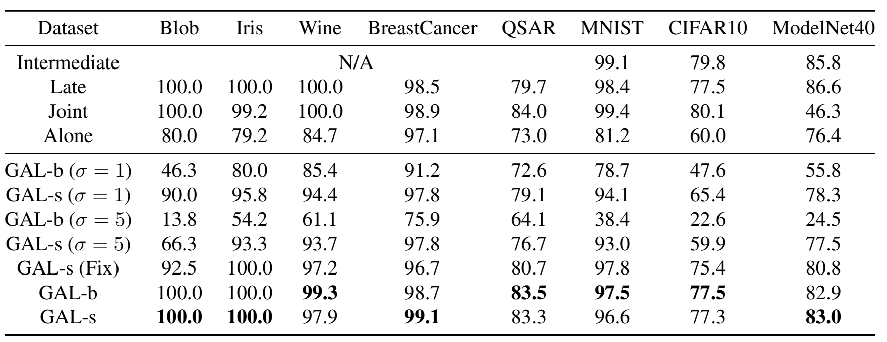
Gradient Assisted Learning
Results
Table 4. Results of classification (Accuracy) experiments. ‘Intermediate’ and ‘Late’ data fusion methods do not preserve data privacy. ’Joint’ refers to one organization with centralized data. ‘Alone’ refers to the first organization has the first split of data. GAL-b and GAL-s are our proposed methods.
Notes:
We conduct ablation study to show the effectiveness of gradient assistance weights and learning rates

Slide 32
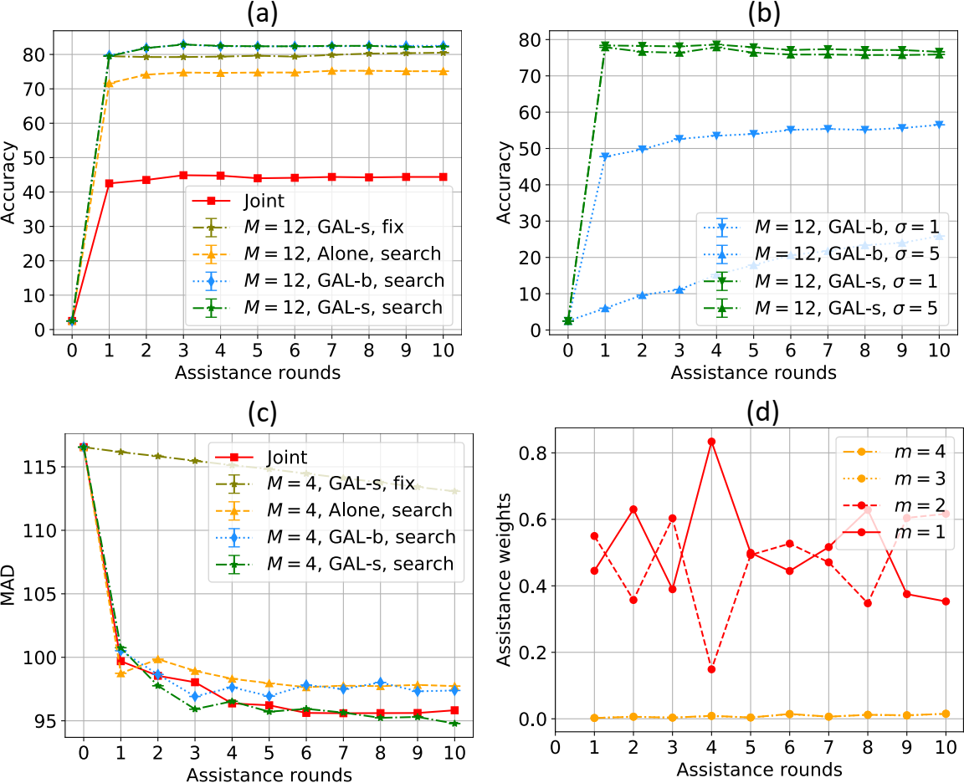
Gradient Assisted Learning
Results
Figure 9. Performance comparison on (a) ModelNet40 noiseless, (b) ModelNet40 with 50% noisy clients (c) MIMIC3 noiseless, (d) MIMIC3 with 50% noisy clients (orange, $σ=5$).
Notes:
We illustrate the learning the performance of our method at each communication round.
I figure (a) our method outperforms Joint case,
(2)

Slide 33
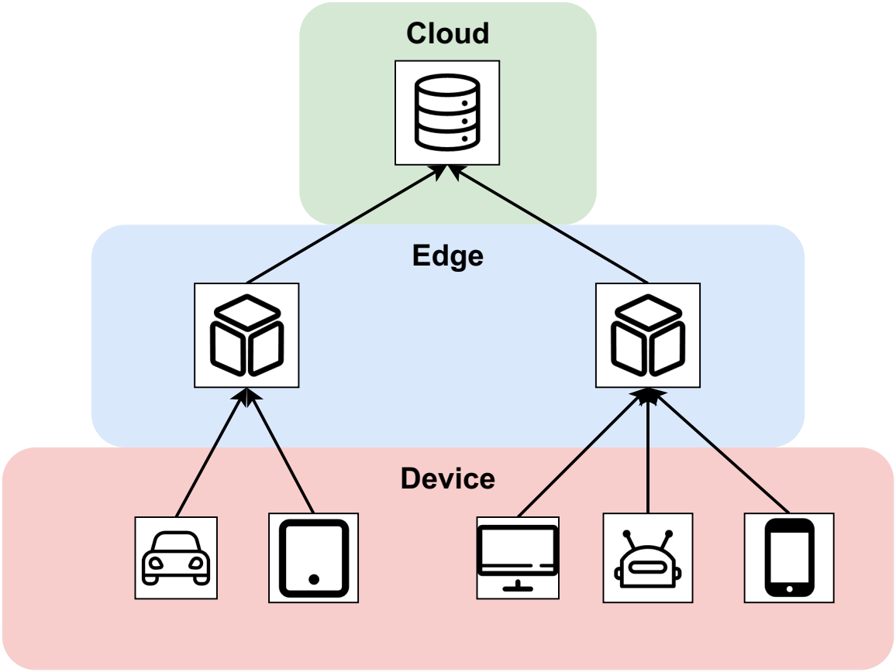
Gradient Decentralized Neural Networks
Motivation
A distributed learning and prediction system for computation offloading
Avoid communication of raw data to the higher level of computation
Figure 10. Gradient Decentralized Neural Networks (GDNN)

Slide 34
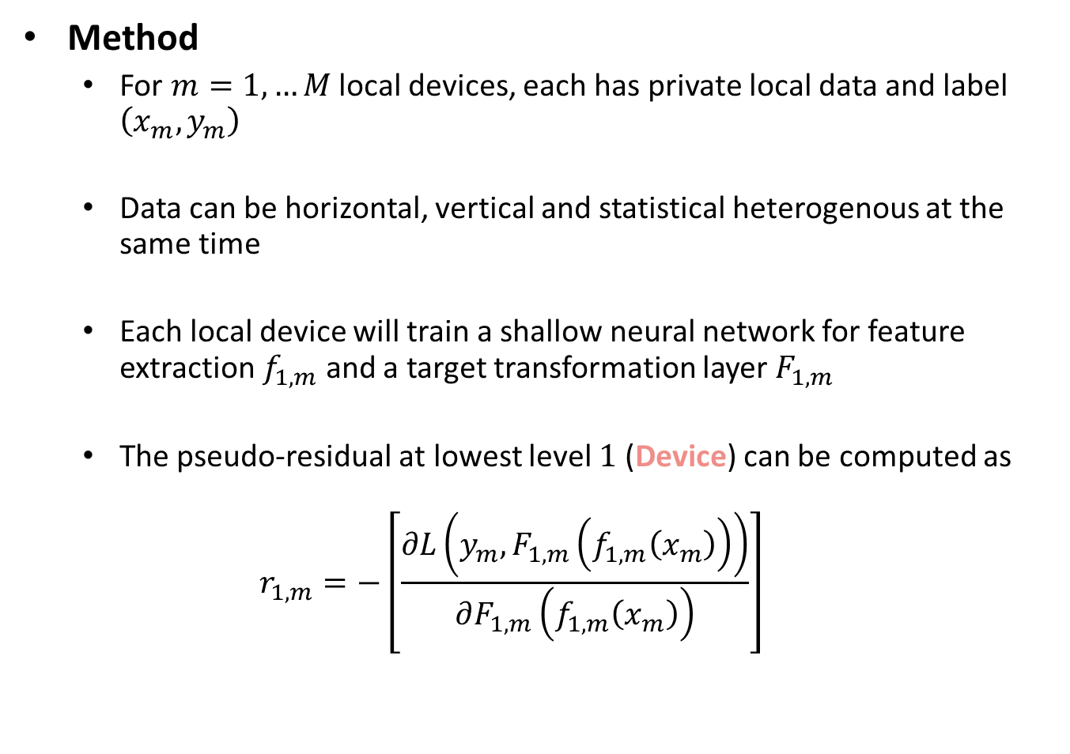
Gradient Decentralized Neural Networks
Method
For $m=1,…M$ local devices, each has private local data and label $\left(x_{m},y_{m}\right)$
Data can be horizontal, vertical and statistical heterogenous at the same time
Each local device will train a shallow neural network for feature extraction $f_{1,m}$ and a target transformation layer $F_{1,m}$
The pseudo-residual at lowest level $1$ (Device) can be computed as
$$r_{1,m}=−\left[\frac{∂L\left(y_{m},F_{1,m}\left(f_{1,m}\left(x_{m}\right)\right)\right)}{∂F_{1,m}\left(f_{1,m}\left(x_{m}\right)\right)}\right]$$

Slide 35









Gradient Decentralized Neural Networks
Method
At level 2 (Edge), we learn and predict on new dataset $\left(f_{1,1:m}\left(x_{1:m}\right),r_{1,1:m}\right)$
This process can iterate until it reaches the final level (Cloud)
$$r_{3,1}$$
$$r_{2,1}$$
$$r_{2,2}$$
$$r_{1,1}$$
$$r_{1,2}$$
$$r_{1,3}$$
$$r_{1,4}$$
$$r_{1,5}$$
Figure 10. Gradient Decentralized Neural Networks (GDNN)

Slide 36
Gradient Decentralized Neural Networks
Experiments
CIFAR10 and ModelNet40 for classification, MIMIC3 for regression, COCO for object detection, and WikiText2 for language modeling
Baseline: DDNN and centralized oracle
Risk
The performance of centralized boosted subnetworks cannot perform as well as the original deep neural network
The gap between centralized and decentralized boosted subnetworks can also be large
Study and develop better boosting and aggregation methods for combining deep subnetworks

Slide 37
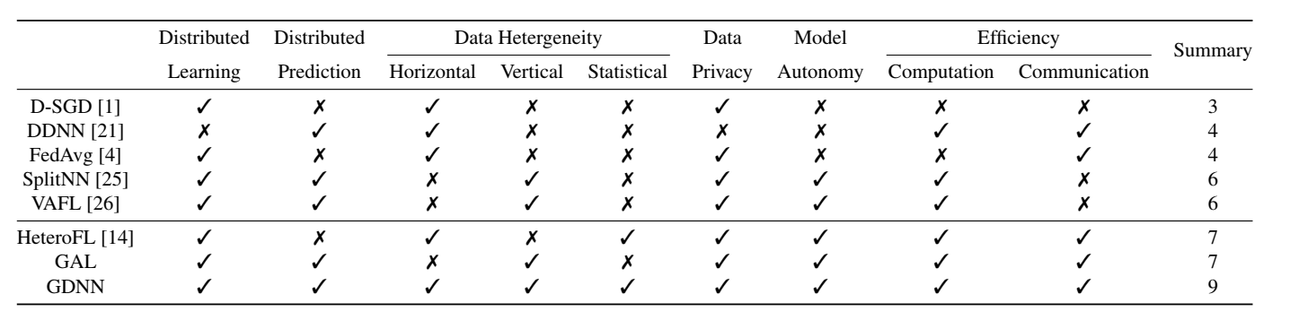
Conclusions
Summary
Our works resolve many limitations of existing works and our proposed work promises a complete solution to all our objectives
Table 7. Comparison among existing works, our works and proposed works against our proposed objectives. Summary shows the number of achieved objectives.

Slide 38
Conclusions
Risks
Achieve all the objectives simultaneously
Implement algorithmic learning framework in applications
Proposed solution
Extend existing works such as FL to achieve more objectives
Provide a trade-off among various objectives
Apply our methods for practical applications such as generative models [24, 25] and recommendation systems [26].
Evaluate the computation and communication efficiency with hardware simulators such as EmuEdge [27].
Notes:
Our objectives have two risks.
First, we aim to achieve all the goals simultaneously, some objectives may become the bottleneck of the others
Second, our work is algorithmic and may not be straightforward to implement in applications
Our solution is that
Gradually climb the ladder
Tangible impact
Pause for questions

Slide 39
Conclusions
We propose five aspects of distributed learning for deep neural networks including
data privacy
model autonomy
heterogeneous data distribution
computation and communication efficiency
distributed learning and prediction
We introduce several related works and compare them with our previous works such as Heterogeneous Federated Learning (HeteroFL) and Gradient Assisted Learning (GAL)
We propose our complete and practical solution, namely Gradient Decentralized Neural Networks (GDNN) to simultaneously achieve all our objectives

Slide 40
References
[1] Diao, Enmao, Jie Ding, and Vahid Tarokh. "HeteroFL: Computation and communication efficient federated learning for heterogeneous clients." arXiv preprint arXiv:2010.01264 (2020).
[2] Nedic, Angelia, and Asuman Ozdaglar. "Distributed subgradient methods for multi-agent optimization." IEEE Transactions on Automatic Control 54.1 (2009): 48-61.
[3] Teerapittayanon, Surat, Bradley McDanel, and Hsiang-Tsung Kung. "Distributed deep neural networks over the cloud, the edge and end devices." 2017 IEEE 37th International Conference on Distributed Computing Systems (ICDCS). IEEE, 2017.
[4] McMahan, Brendan, et al. "Communication-efficient learning of deep networks from decentralized data." Artificial Intelligence and Statistics. PMLR, 2017.
[5] Yang, Qiang, et al. "Federated machine learning: Concept and applications." ACM Transactions on Intelligent Systems and Technology (TIST) 10.2 (2019): 1-19.
[6] Li, Tian, et al. "Federated learning: Challenges, methods, and future directions." IEEE Signal Processing Magazine 37.3 (2020): 50-60.
[7] Dwork, Cynthia. "A firm foundation for private data analysis." Communications of the ACM 54.1 (2011): 86-95.
[8] Ding, Jie, and Bangjun Ding. "" To Tell You the Truth" by Interval-Private Data." 2020 IEEE International Conference on Big Data (Big Data). IEEE, 2020.
[9] Rodríguez-Barroso, Nuria, et al. "Federated Learning and Differential Privacy: Software tools analysis, the Sherpa. ai FL framework and methodological guidelines for preserving data privacy." Information Fusion 64 (2020): 270-292.
[10] Zhu, Ligeng, and Song Han. "Deep leakage from gradients." Federated Learning. Springer, Cham, 2020. 17-31.
[11] Sattler, Felix, et al. "Communication-Efficient Federated Distillation." arXiv preprint arXiv:2012.00632 (2020).
[12] Li, Daliang, and Junpu Wang. "Fedmd: Heterogenous federated learning via model distillation." arXiv preprint arXiv:1910.03581 (2019).
[13] Diao, Enmao, Jie Ding, and Vahid Tarokh. "Restricted recurrent neural networks." 2019 IEEE International Conference on Big Data (Big Data). IEEE, 2019.
[14] Wu, Suya, et al. "Deep Clustering of Compressed Variational Embeddings." arXiv preprint arXiv:1910.10341 (2019).
[15] Diao, Enmao, Jie Ding, and Vahid Tarokh. "DRASIC: Distributed Recurrent Autoencoder for Scalable Image Compression." 2020 Data Compression Conference (DCC). IEEE, 2020.
[16] Momenifar, Mohammadreza, et al. "Dimension Reduced Turbulent Flow Data From Deep Vector Quantizers." arXiv preprint arXiv:2103.01074 (2021).
[17] Liang, Paul Pu, et al. "Think locally, act globally: Federated learning with local and global representations." arXiv preprint arXiv:2001.01523 (2020).
[18] Friedman, Jerome H. "Greedy function approximation: a gradient boosting machine." Annals of statistics (2001): 1189-1232.
[19] Ceballos, Iker, et al. "SplitNN-driven Vertical Partitioning." arXiv preprint arXiv:2008.04137 (2020).
[20] Chen, Tianyi, et al. "Vafl: a method of vertical asynchronous federated learning." arXiv preprint arXiv:2007.06081 (2020).
[21] Xian, Xun, et al. "Assisted Learning: A Framework for Multi-Organization Learning." Advances in Neural Information Processing Systems 33 (2020).
[22] Su, Hang, et al. "Multi-view convolutional neural networks for 3d shape recognition." Proceedings of the IEEE international conference on computer vision. 2015.
[23] Harutyunyan, Hrayr, et al. "Multitask learning and benchmarking with clinical time series data." Scientific data 6.1 (2019): 1-18.
[24] Rasouli, Mohammad, Tao Sun, and Ram Rajagopal. "Fedgan: Federated generative adversarial networks for distributed data." arXiv preprint arXiv:2006.07228 (2020).
[25] Diao, Enmao, Jie Ding, and Vahid Tarokh. "Multimodal controller for generative models." arXiv preprint arXiv:2002.02572 (2020).
[26] Liu, Yang, et al. "A communication efficient collaborative learning framework for distributed features." arXiv preprint arXiv:1912.11187 (2019).
[27] Zeng, Yukun, Mengyuan Chao, and Radu Stoleru. "Emuedge: A hybrid emulator for reproducible and realistic edge computing experiments." 2019 IEEE International Conference on Fog Computing (ICFC). IEEE, 2019.

Slide 41
Thank you

